Slide 1


Dipartimento di Elettronica, Informazione e Bioingegneria
2025
AI@Edge in Biomedical Applications
Anna Maria Stucchi - 10797657
Milano, agosto 2025

Slide 2
AI@Edge in Biomedical Applications Accelerators for Machine Learning on Embedded Devices
Introduction & motivation
Background: Edge AI and accelerators
Main hardware platforms
Lightweight networks & software tools
Biomedical applications
Challenges and future trends
Conclusions & repository

Slide 3
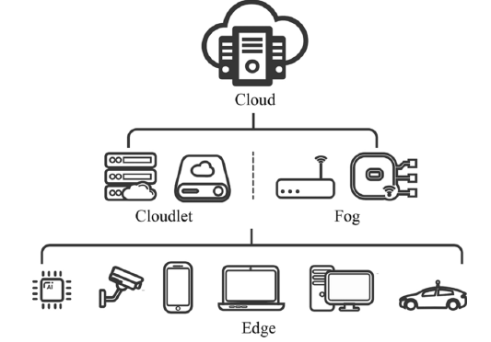
Introduction & Motivation What is Edge AI?
Edge AI = deployment of machine learning models on embedded/edge devices
Operates close to the data source (e.g., sensors, cameras, wearables)
Complements cloud computing → reduces latency, improves privacy and bandwidth efficiency

Slide 4



Introduction & Motivation Why in Biomedical Applications?
Real-time requirements:
Emergency diagnostics (ambulances, ICU)
Continuous monitoring of chronic patients
Data sensitivity:
Patient health data must remain local (HIPAA/GDPR compliance)
Accessibility:
Portable and affordable AI devices → broader access to healthcare

Slide 5
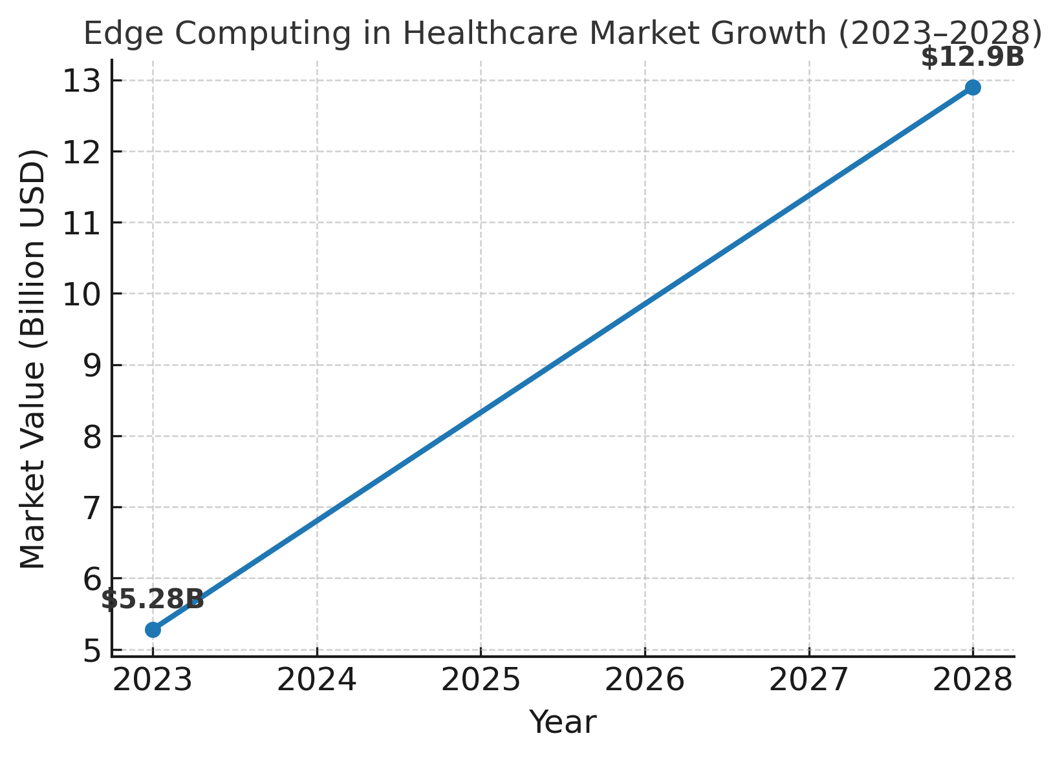
Introduction & Motivation Market & Research Trends
Global Edge computing in healthcare market:
Valued at USD 5.28B in 2023, expected to reach USD 12.9B by 2028 (CAGR 26.1%)
Increasing adoption of AI-based medical devices (Intel, NVIDIA, Apple, Google TPU)
Research shift: from cloud-only AI → towards edge + AI co-design

Slide 6
Introduction & Motivation
Healthcare is moving towards point-of-care (medical tests performed at or near the patient's location) diagnostics and remote monitoring
Embedded AI accelerators enable:
Fast inference
Low-power consumption
On-device medical applications

Slide 7
Background: Edge AI and Accelerators Edge AI: Concept
Definition: Deployment of deep learning networks (DNN) on edge devices (close to data sources such as sensors, wearables, cameras), bringing artificial intelligence closer to the data source
Benefits over cloud computing:
Low latency
Privacy and data protection
Reduced bandwidth usage
Key enablers: IoT, 5G, efficient ML accelerators

Slide 8
Background: Edge AI and Accelerators Challenges
Resource constraints: limited CPU/GPU, memory, power
Large models (CNNs, Transformers) are too heavy for microcontrollers
Heterogeneity of hardware/software → portability issues
Standardization and regulatory barriers in medical devices

Slide 9
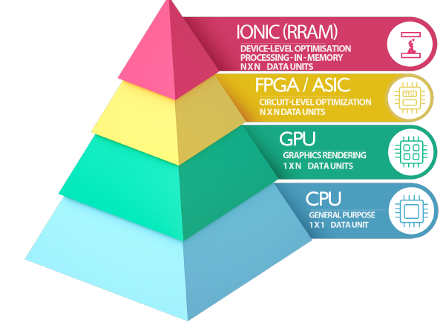
Background: Edge AI and Accelerators What are ML Accelerators?
Definition: Hardware specifically designed to speed up AI inference/training tasks
Main categories:
ASICs (e.g., Google Edge TPU, Apple Neural Engine)
FPGAs (flexible, reconfigurable, good for prototyping)
GPUs (general-purpose parallel processing, e.g., NVIDIA Jetson)
Memristor-based / Neuromorphic chips (next-gen, energy efficient)
Key features: throughput (TOPS), latency, power efficiency, programmability

Slide 10
Background: Edge AI and Accelerators Classification of Edge Devices
Low-end: microcontrollers (e.g., STM32, SparkFun Edge) → wearables, lightweight inference
Medium-range: boards (e.g., Raspberry Pi + NCS2, Google Coral Dev Board, Jetson Nano) → portable medical imaging, pathology screening
High-performance: Jetson Xavier, Orin, workstations → real-time CT/MRI analysis, robotics in surgery

Slide 11
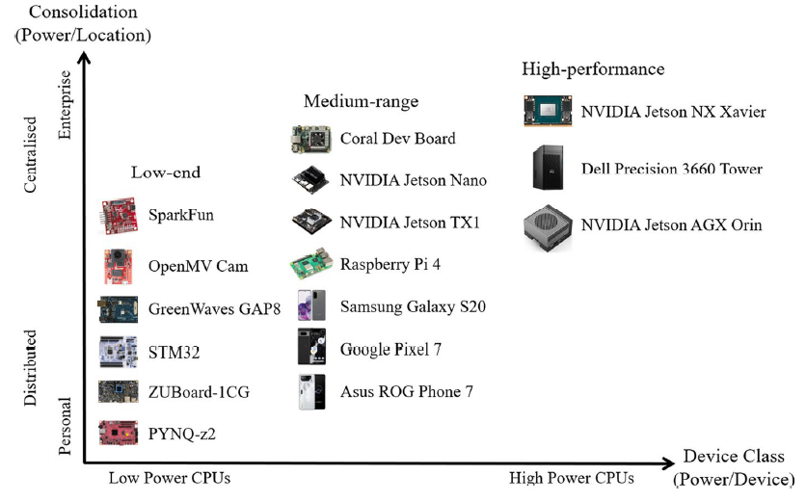
Background: Edge AI and Accelerators Classification of Edge Devices

Slide 12
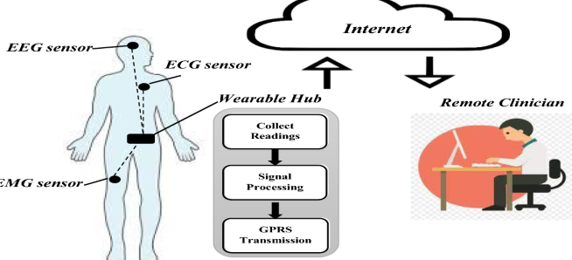
Background: Edge AI and Accelerators Relevance to Biomedical Applications
Wearable sensors: continuous monitoring of ECG/EEG/EMG
Portable diagnostic devices: ultrasound, dermatology cameras, retinal screening
Critical care: ICU patient monitoring, telemedicine in remote areas
Accelerators enable near real-time inference with low power and high reliability

Slide 13
Main Hardware Platforms Overview
Hardware accelerators enable real-time, low-power inference on embedded devices
Categories:
ASICs (fixed-function, very efficient)
FPGAs (reconfigurable, versatile)
GPUs/NPUs (high throughput, flexible)
Memristor/Neuromorphic (emerging hardware, bio-inspired)
Each platform offers a different trade-off:
performance vs. flexibility vs. energy

Slide 14
Main Hardware Platforms Why specialized Accelerators?
CPUs are general-purpose → inefficient for deep learning
Accelerators exploit parallelism in matrix operations
Goal: high throughput, low latency, low energy per inference
Accelerators implement:
MAC arrays (Multiply-Accumulate units)
Low-precision arithmetic (8-bit, 4-bit, even binary ops)
On-chip memory to reduce data transfer costs

Slide 15
Main Hardware Platforms Key Performance Metrics
TOPS (Tera Operations per Second) → raw compute
TOPS/Watt → energy efficiency
Latency → time to process one inference
Memory bandwidth → critical for large models
Programmability → flexibility vs. fixed hardware

Slide 16
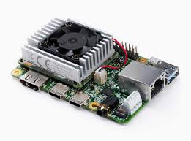
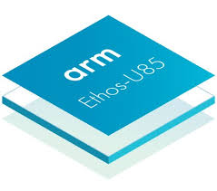
Main Hardware Platforms ASIC Accelerators
Examples: Google Edge TPU, Apple Neural Engine (ANE), ARM Ethos-U NPU
Advantages: ultra-low power, small form factor, optimized for inference
Limitations: fixed functionality, less flexible for new models
Biomedical use cases:
Portable retinal imaging (Edge TPU)
Wearable ECG analysis (ANE in Apple Watch)

Slide 17
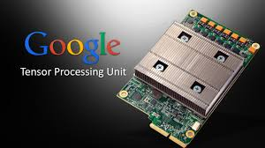
Main Hardware Platforms ASIC Accelerators: Google Edge TPU
Optimized for 8-bit quantized TensorFlow Lite models
4 TOPS at <2 W → very energy efficient
Used in Coral Dev Board (diagnostic cameras, IoT healthcare)
Limitation: no floating-point, less flexibility

Slide 18
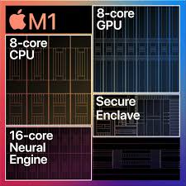
Main Hardware Platforms ASIC Accelerators: Apple Neural Engine (ANE)
Integrated in iPhones & Apple Watch
Handles biometric authentication and ECG anomaly detection
16-core engine, ~17 TOPS (iPhone 14 Pro)
Highly optimized for health-oriented apps

Slide 19
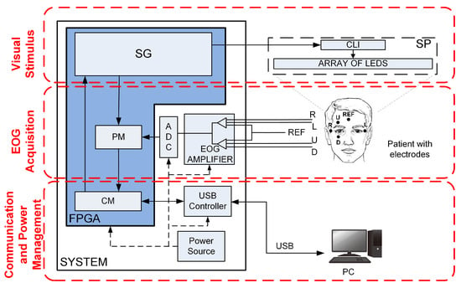
Main Hardware Platforms FPGA-based Accelerators
Reconfigurable hardware → customizable for specific AI tasks
Tools: OpenCL, High-Level Synthesis, Vitis AI
Advantages: flexibility, energy efficiency, prototyping new models
Limitations: programming complexity, less mature software ecosystem
Biomedical use cases:
EEG/ECG anomaly detection
EMG-based prosthetic control
Portable ultrasound image processing

Slide 20
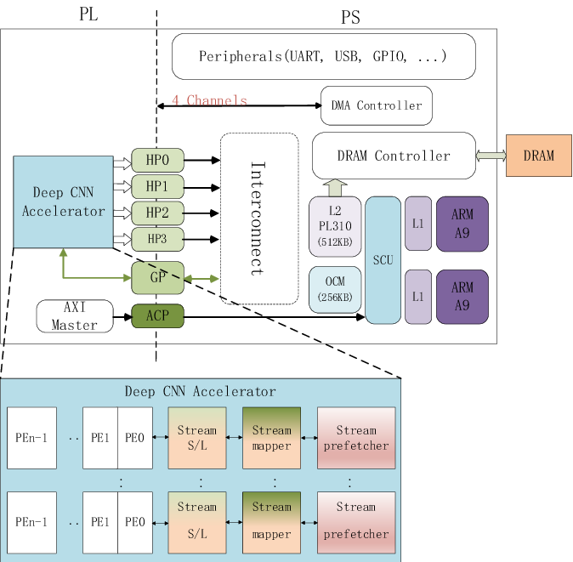
Main Hardware Platforms FPGA-based Accelerators: Xilinix Zynq
Customizable pipelines for CNN/ECG/EEG
Toolchains: Vitis AI, High-Level Synthesis
Advantage: can adapt architecture to medical task
Limitation: longer development cycle

Slide 21
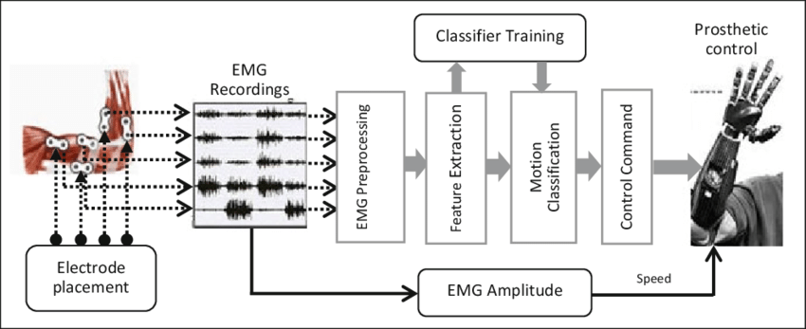
Main Hardware Platforms FPGA Case Study in Biomedicine
EMG classification for prosthetic control
FPGA provided 20× lower latency vs CPU
Demonstrated feasibility for real-time prosthetics
Trade-off: development complexity

Slide 22
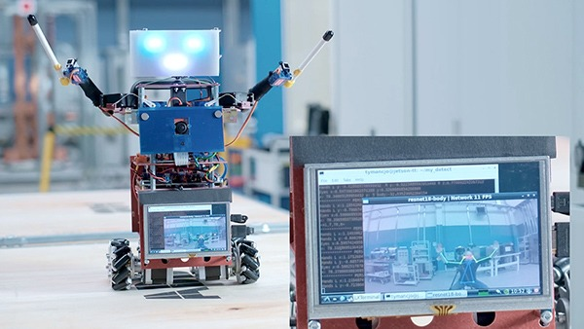
Main Hardware Platforms GPU & NPU Platforms
Embedded GPUs: NVIDIA Jetson Nano, Xavier, Orin → high parallelism, full DL frameworks (TF, PyTorch, ONNX)
NPUs (specialized processor designed to accelerate computations needed for AI): Qualcomm Hexagon DSP, Huawei Ascend → optimized for mobile inference
Advantages: flexibility, strong software support
Limitations: higher power consumption
Biomedical use cases:
MRI/CT real-time segmentation (Jetson Orin)
Smartphone-based medical imaging with NPUs

Slide 23
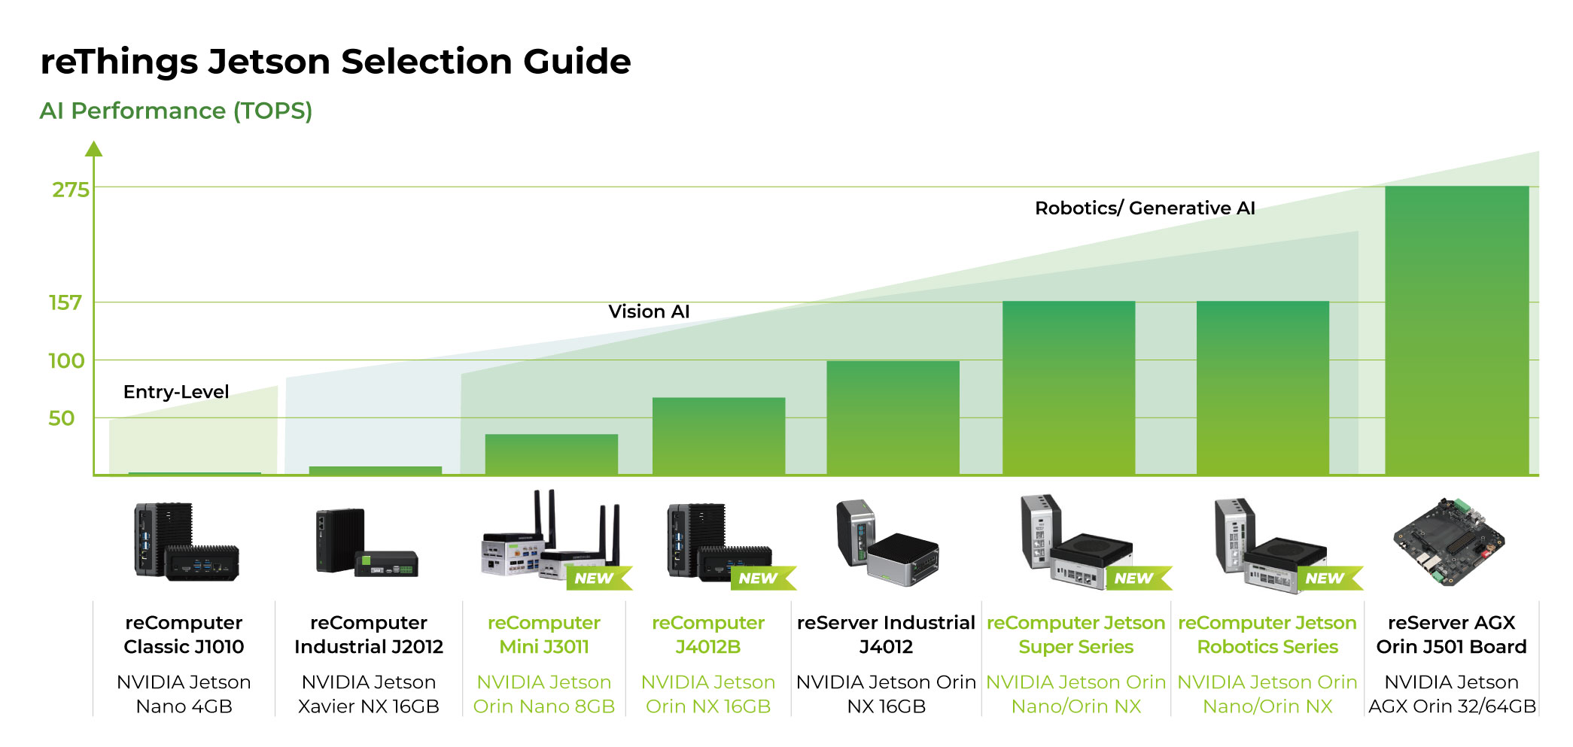
Main Hardware Platforms GPU for Edge: NVIDIA Jetson Family
Jetson Nano → 0.5 TFLOPS, entry-level
Jetson Xavier NX → 21 TOPS, balance of power/efficiency
Jetson Orin → up to 200 TOPS, advanced imaging tasks
Supports full DL frameworks (TF, PyTorch, ONNX)

Slide 24
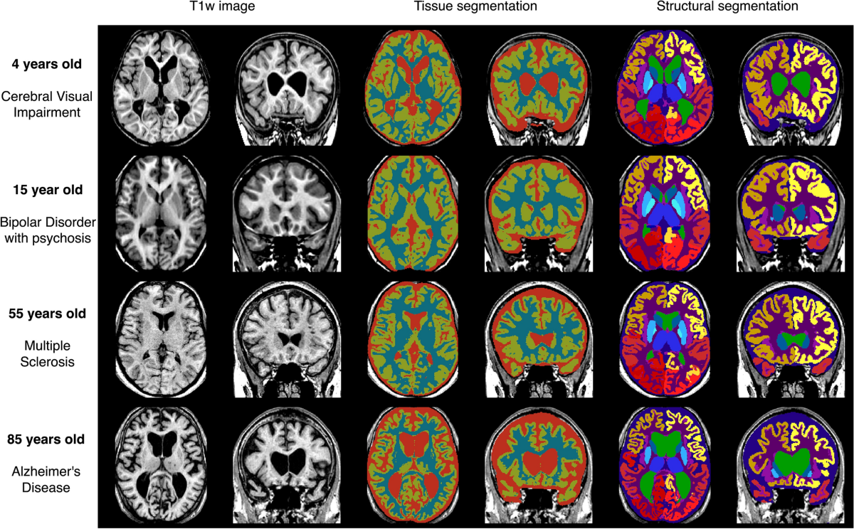
Main Hardware Platforms GPU Case Study in Medical Imaging
Jetson Xavier used for MRI segmentation
Achieved real-time inference with <250 ms latency
Applications: CT anomaly detection, ultrasound analysis

Slide 25
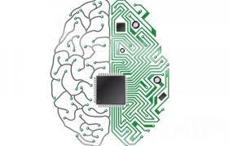
Main Hardware Platforms Memristor & Neuromorphic Accelerators
Memristors: enable in-memory computing → lower latency, energy efficiency
Neuromorphic chips: IBM TrueNorth, Intel Loihi → inspired by brain networks
Advantages: ultra-low power, suitable for biomedical sensors and implants
Challenges: device variability, limited maturity, standardization issues
Biomedical use cases:
EMG/EEG signal classification (prototypes)
Spiking neural networks for prosthetics & brain-computer interfaces

Slide 26
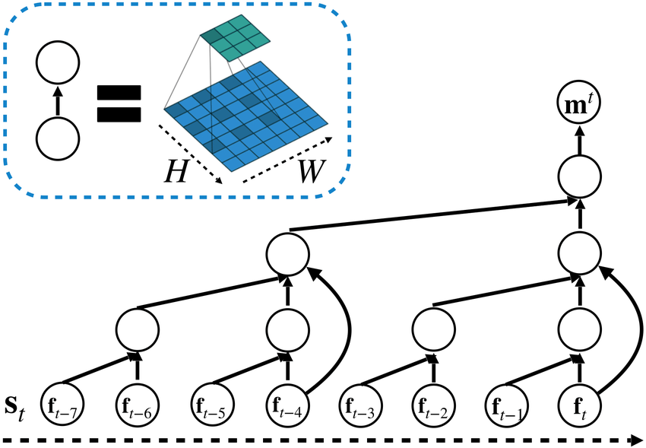
Main Hardware Platforms Memristor Accelerators
In-memory computing → reduces data movement
Advantages: low power, high parallelism
Used in MDNN (Memristor-based DNNs)
Tools: MemTorch (open-source simulation)
Challenge: device variability & reproducibility

Slide 27
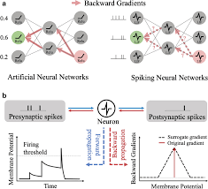
Main Hardware Platforms Neuromorphic Computing
Chips inspired by the brain: spiking neural networks (SNNs)
Intel Loihi, IBM TrueNorth
Ultra-low-power, event-driven processing
Applications: continuous EEG/ECG monitoring, implants
Challenge: not yet mainstream in clinical devices

Slide 28
Main Hardware Platforms Comparison Table (general)
Platform | Examples | Pros | Cons | Biomedical Use
ASIC | Edge TPU, ANE | Low power, efficient | Fixed function | Wearables, mobile diag.
FPGA | Xilinx Zynq, Intel Stratix | Reconfigurable, efficient | Complex programming | EEG/ECG, prosthetics
GPU/NPU | Jetson, Qualcomm DSP | Flexible, strong SW support | High power | Imaging, real-time diag.
Memristor/Neuromorphic | Loihi, MemTorch | Ultra-low power, bio-inspired | Immature, limited support | BCI, implants

Slide 29
Main Hardware Platforms Comparison Table
Accelerator | Example | Perf (TOPS) | Power | Biomedical Use
ASIC | Google Edge TPU | 4 | <2W | Retinal imaging, wearables
ASIC | Apple Neural Engine | 17 | Smartphone power budget | ECG detection
FPGA | Xilinx Zynq | Custom | 5–10W | EMG prosthetics, EEG
GPU | Jetson Xavier NX | 21 | 10–15W | MRI/CT, ultrasound
GPU | Jetson Orin | 200 | 25–50W | Robotics, advanced imaging
Memristor | MDNN proto | — | mW range | In-memory ML (research)
Neuromorphic | Intel Loihi | — | Ultra-low | EEG, implants

Slide 30
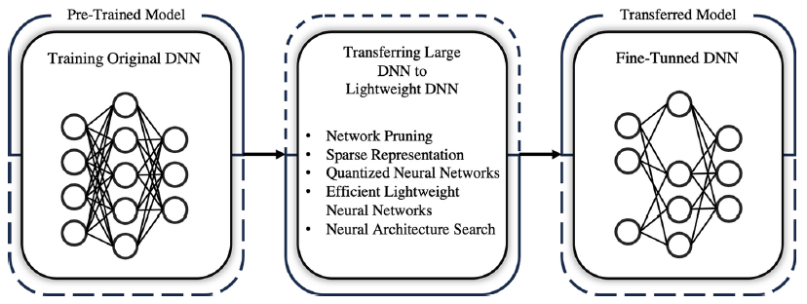
Lightweight Models & Software Tools Why lightweight Models?
Transferring large DNNs to lightweight DNNs
Edge devices → limited memory, power, compute capacity
Standard CNNs (ResNet, VGG) too large for microcontrollers
Need compression & efficient architectures for on-device ML

Slide 31
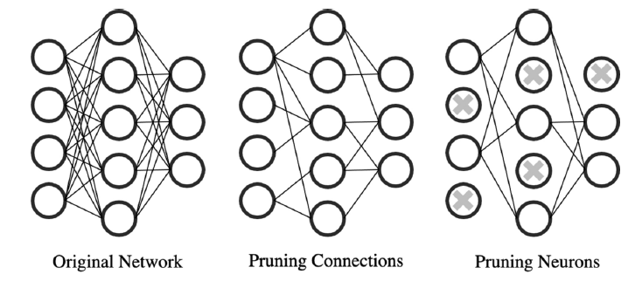
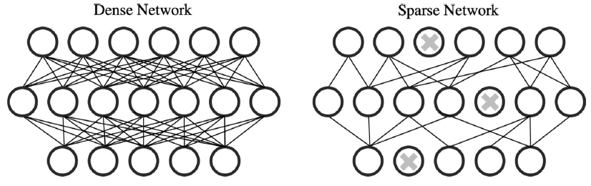
Lightweight Models & Software Tools Techniques for Model Optimization
Pruning (remove redundant neurons/weights)
Quantization (reduce precision, e.g., 32-bit → 8-bit)
Sparse representation
Neural Architecture Search (NAS)
Knowledge distillation (transfer learning from large → small models)

Slide 32
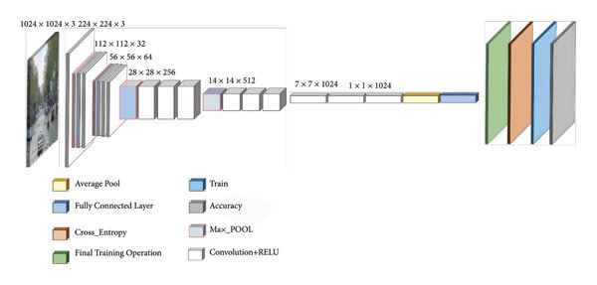
Lightweight Models & Software Tools Lightweight Architectures
Nowadays many neural network architectures are lightweighted by design rather than reducing a given large network.
MobileNet (V1–V3) – efficient CNN for mobile devices (used in diagnostic instruments)
EfficientNet – compound scaling for accuracy & efficiency
ShuffleNet, SqueezeNet, GhostNet – ultra-low resource use (group convolutional networks)
Mobile Transformers (MobileViT, EdgeViT) – balance accuracy & latency

Slide 33
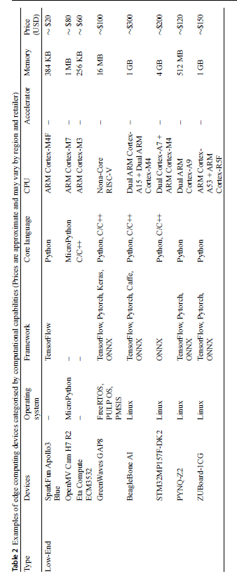
Lightweight Models & Software Tools Software frameworks
TensorFlow Lite – inference on microcontrollers
PyTorch Mobile / ExecuTorch – optimized for smartphones
ONNX Runtime – portability across accelerators
OpenVINO (Intel) – optimized inference on CPUs/VPUs
NVIDIA Triton – deployment across Jetson devices

Slide 34
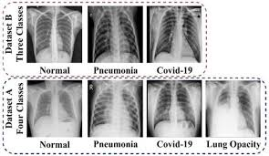
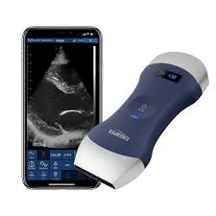
Biomedical Applications Medical Imaging
Portable ultrasound with Edge AI
Retinal fundus screening for diabetic retinopathy
X-ray anomaly detection (pneumonia, fractures) on mobile devices

Slide 35
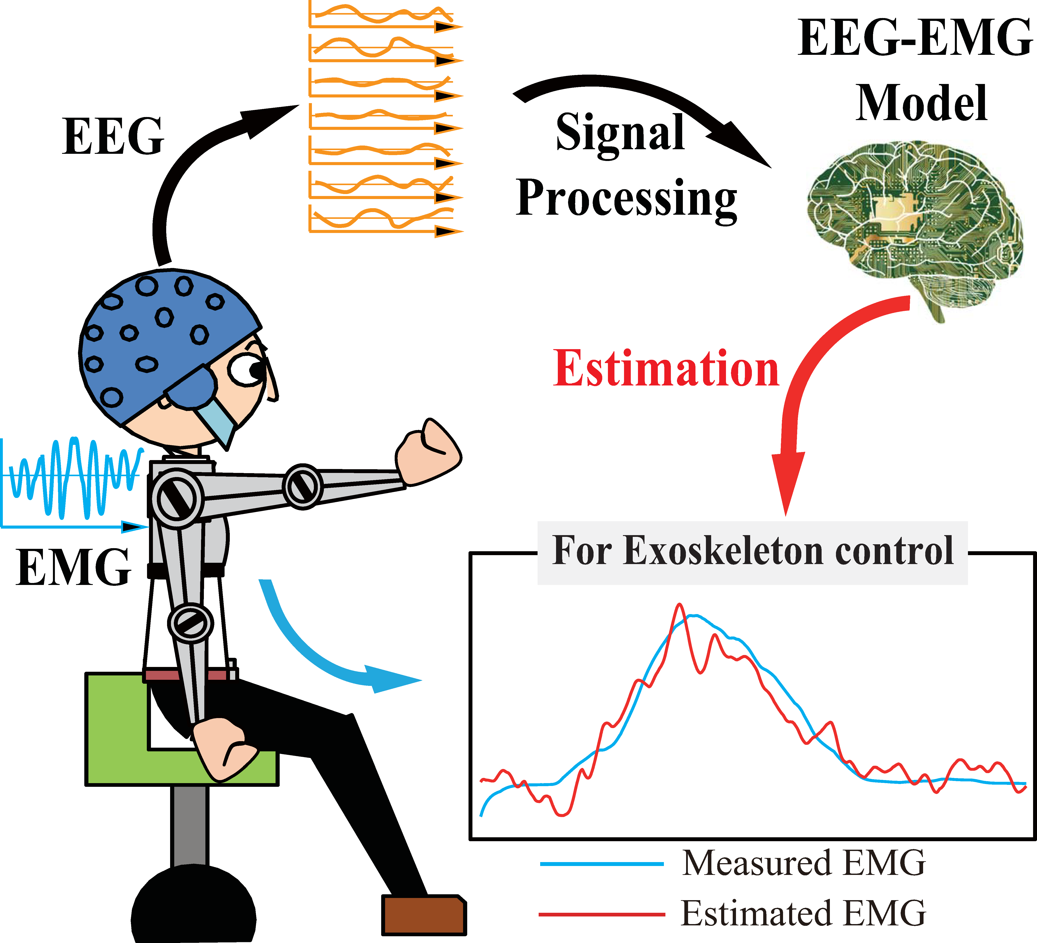
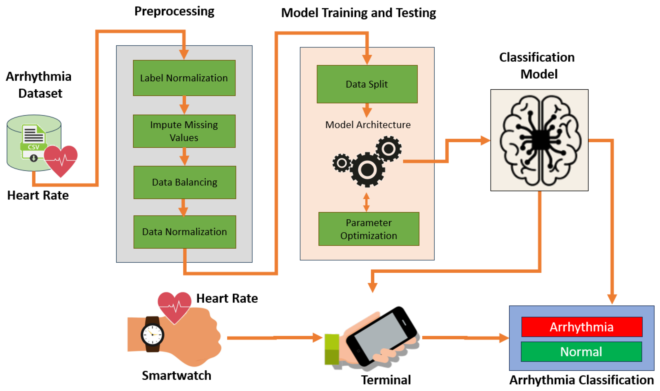
Biomedical Applications Wearable Devices
ECG monitoring with real-time anomaly detection
EEG/EMG analysis for neuroprosthetics
Smartwatches detecting arrhythmias

Slide 36
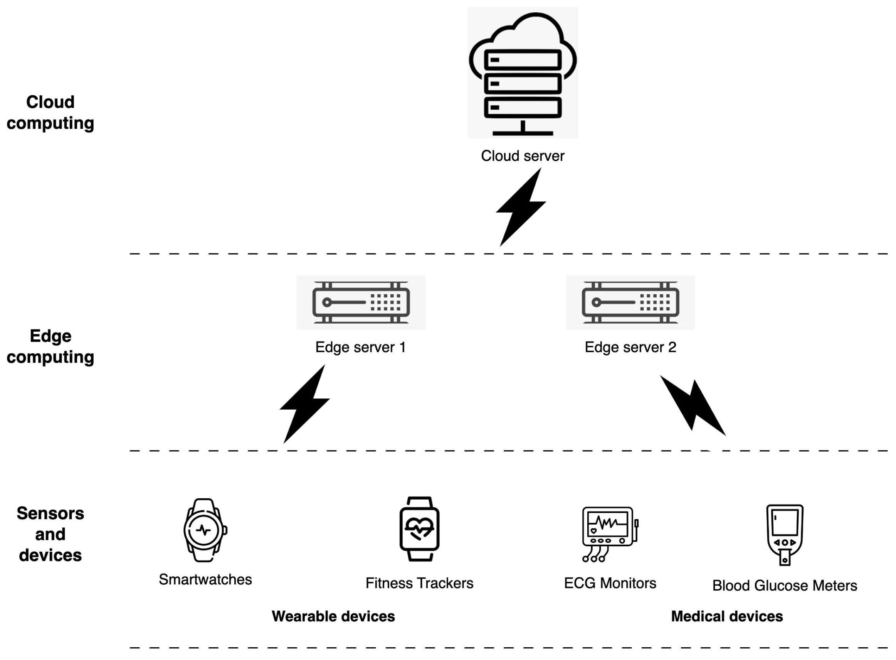
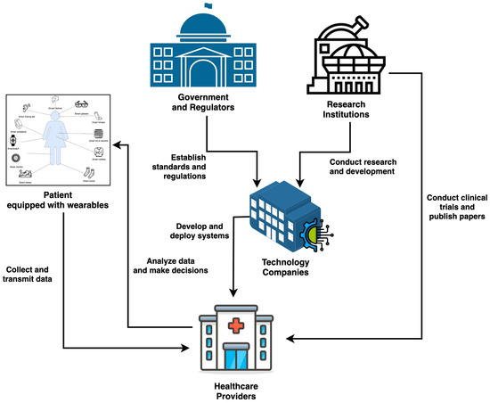
Biomedical Applications Point-of-Care Devices
AI-enabled diagnostic kits for rural/low-resource settings
Edge AI for emergency care (ambulances, portable scanners)
Reduces dependency on cloud → more autonomy

Slide 37
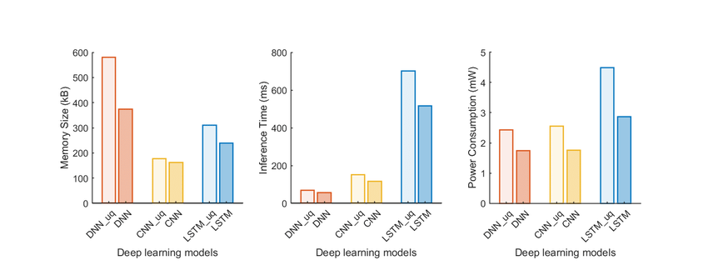
Challenges & Limitations Technical Challenges
Limited compute, memory, energy vs. large DL models
Hardware heterogeneity → portability issues
Lack of standardized APIs across accelerators

Slide 38


Challenges & Limitations Biomedical-Specific Challenges
Data privacy & regulation (HIPAA, GDPR)
Validation & certification of AI-powered medical devices
Accuracy trade-offs in lightweight models for critical tasks

Slide 39

Challenges & Limitations Economic & Market Barriers
High costs for high-performance accelerators
Limited availability in low-resource healthcare systems
Need for scalable, affordable solutions

Slide 40
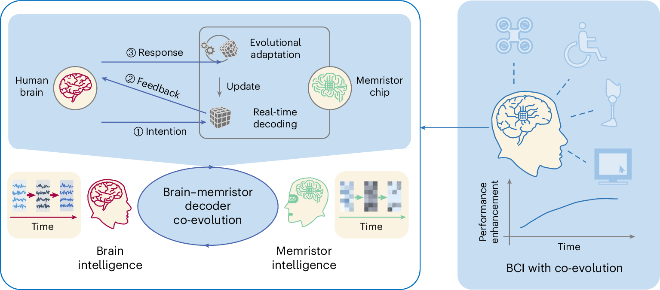
Future Trends Neuromorphic & Memristor-Based AI
Brain-inspired accelerators for ultra-low-power computation
Suitable for implantable or continuous-monitoring medical devices
Still early-stage → research prototypes

Slide 41
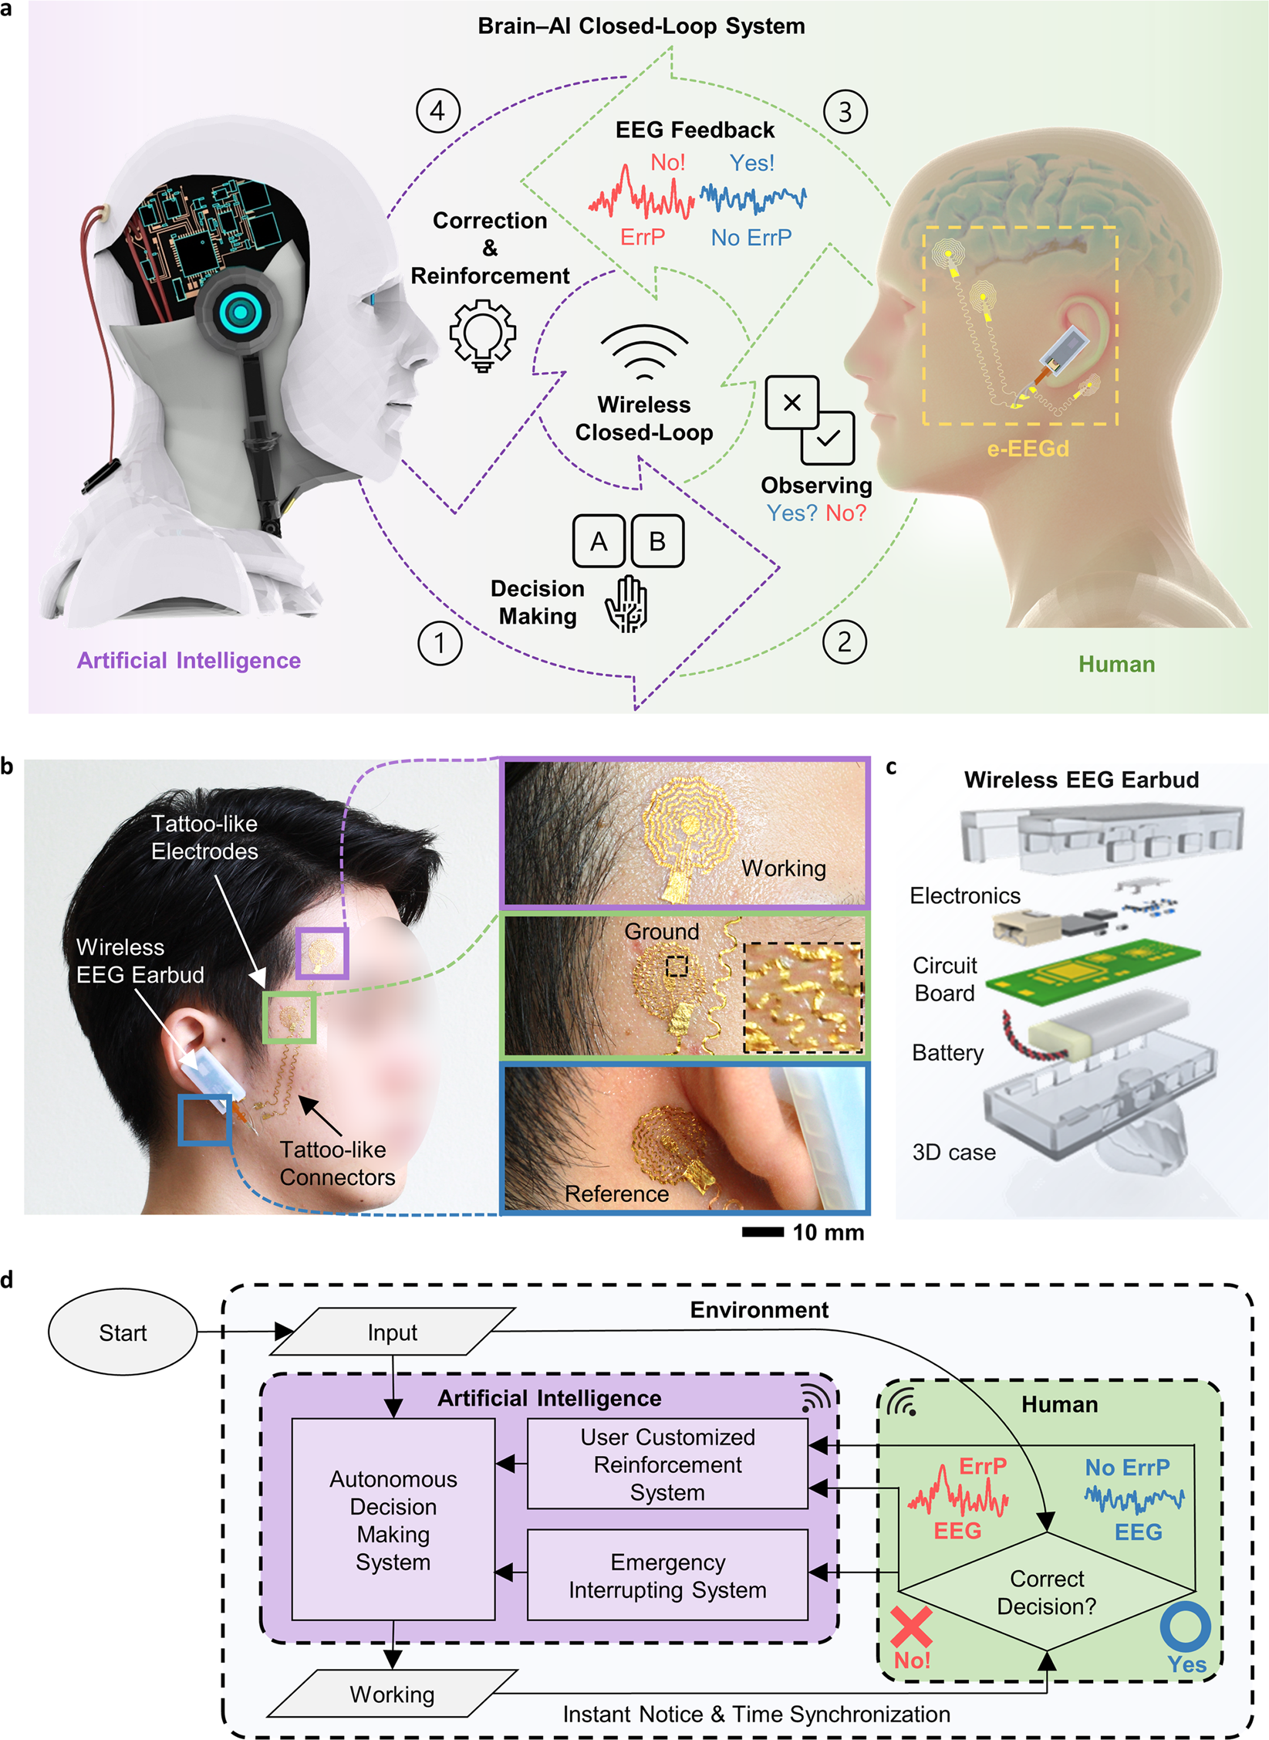
Future Trends Federated & On-Device Learning
Training directly on local devices → improved personalization
Preserves privacy (no raw data transfer)
Example: collaborative ECG/EEG learning across wearables

Slide 42

Future Trends Integration with Healthcare Systems
Hybrid cloud–edge architectures
Standardization & regulatory frameworks needed
Edge AI as a complement, not a replacement, of cloud AI

Slide 43

Conclusion
Edge AI enables real-time, private, efficient biomedical applications
Hardware accelerators (ASIC, FPGA, GPU, memristors) are central
Lightweight models + optimized frameworks make deployment feasible
Combination of hardware innovation + lightweight models will shape future medical devices
Still open: standardization, validation, certification

Slide 44
References
Repository with slides and sources
https://github.com/annastucchi/desk-research-ai-edge-biomedical/tree/main
[1] Rahimi et al. (2020) - https://arxiv.org/abs/2007.05657
[2] Xu et al. (2025) - https://link.springer.com/article/10.1007/s10462-024-11033-5
[3] Google Coral Benchmarks - https://coral.ai/docs/edgetpu/benchmarks/
[4] NVIDIA Jetson Orin Nano - https://developer.nvidia.com/blog/solving-entry-level-edge-ai-challenges-with-nvidia-jetson-orin-nano/
[5] DeepEdgeBench (Blott et al., 2021) - https://arxiv.org/abs/

Slide 45
Anna Maria Stucchi
Master’s student in computer engineering
CONTACT
annamaria.stucchi@mail.polimi.it

